Slide 1
Horse Breed Id
Unit: Breed Identification * Equine Science

Slide 2
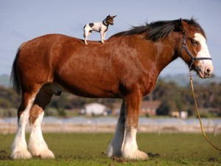
clydesdale

Slide 3
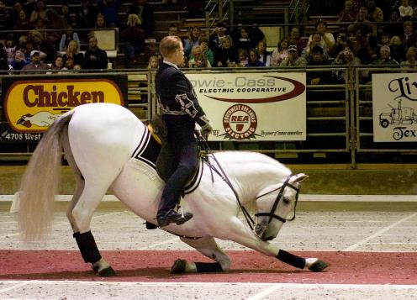
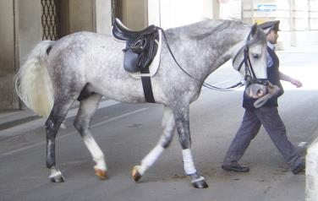
Lipizzaner
Other Info:
  Great athletic ability performing “airs about the ground”

Slide 4
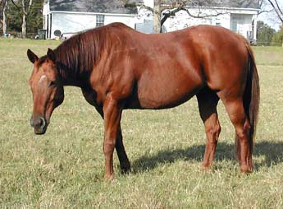
Quarterhorse

Slide 5
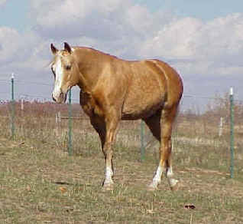
Missouri Fox Trotter

Slide 6
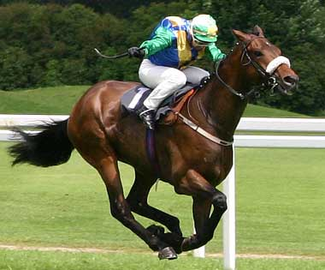
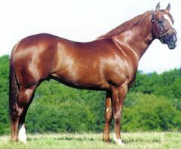
Thoroughbred

Slide 7
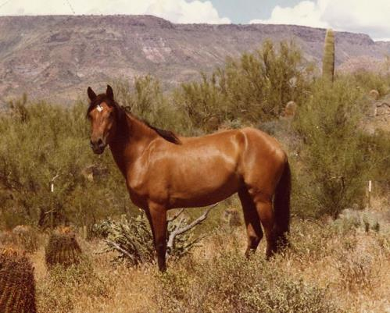
Mustang

Slide 8
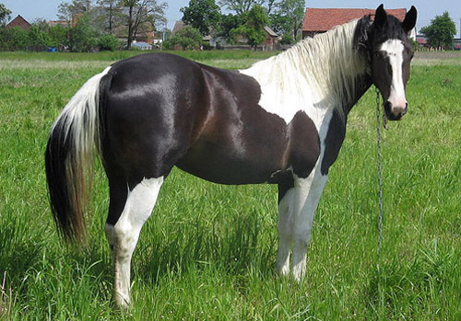
Pinto

Slide 9
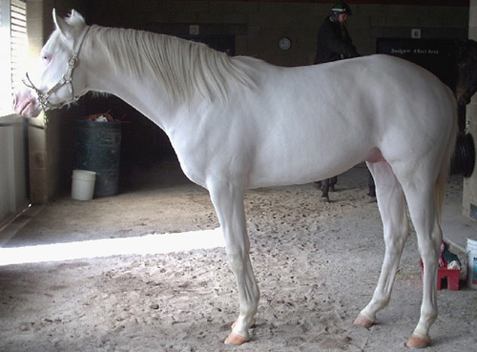
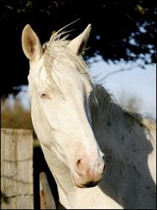
American Albino

Slide 10
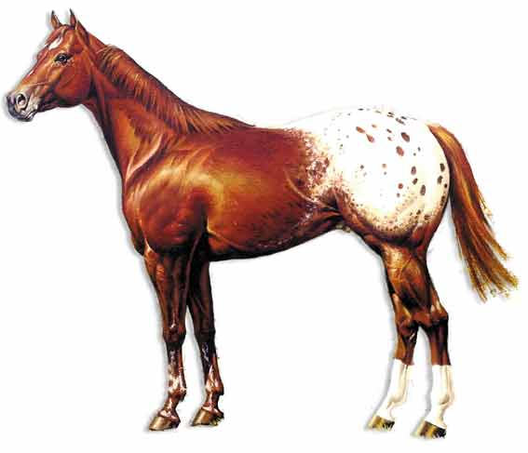


Appaloosa

Slide 11
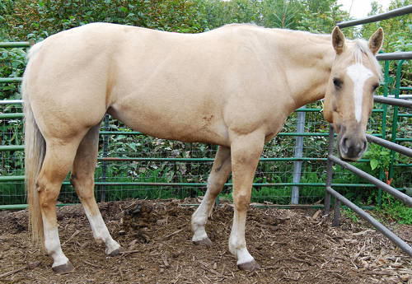
Palomino

Slide 12
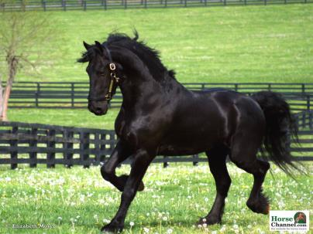
#2
Origin:
  Holland
Classification:
  Draft
Height:
  15 hh
Color:
  Black

Slide 13
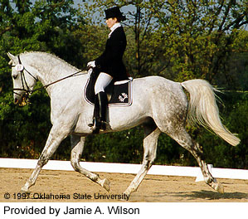
Trakehner
Origin:
  Europe – East Prussia (Lithuania)
Classification:
  Light - Warmblood
Height:
  16-17 hh
Color:
  Chestnut, gray, bay, black

Slide 14
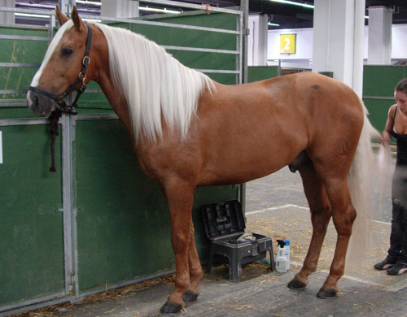
Palomino

Slide 15
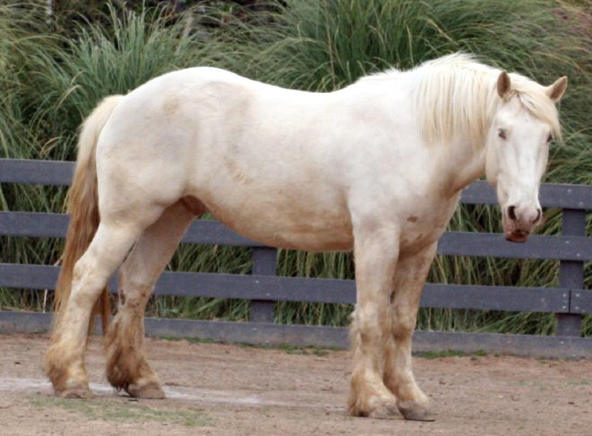
American Cream

Slide 16
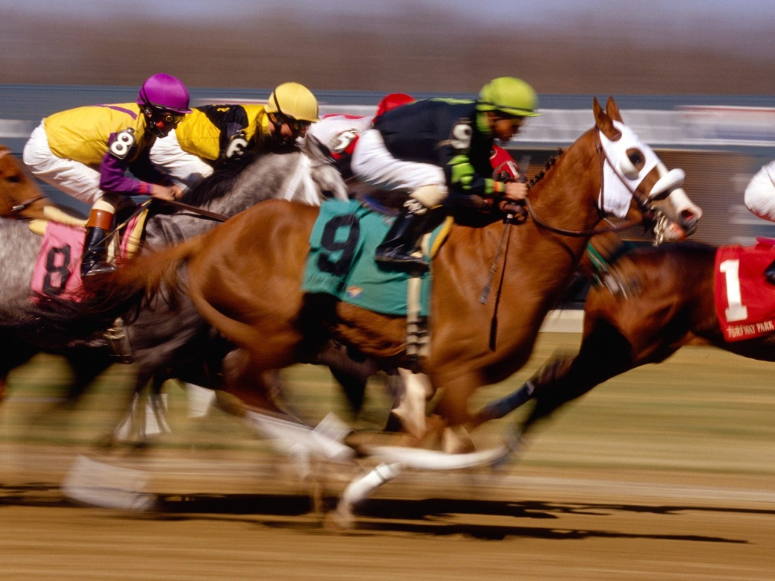
Thoroughbred

Slide 17
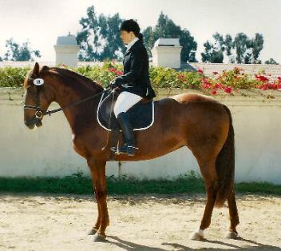
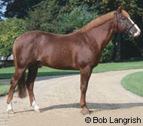
Selle Francais
Other Info
  Great sport horses
  Excels in show jumping
  Great in dressage and eventing
  Also called French Saddle Horse

Slide 18
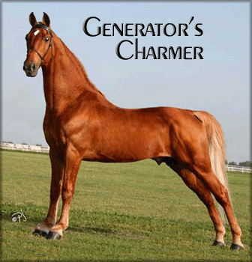
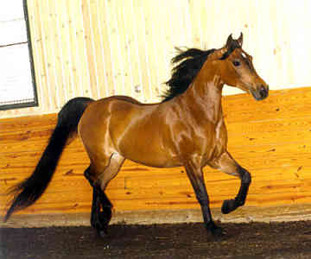
Tennessee Walking Horse

Slide 19
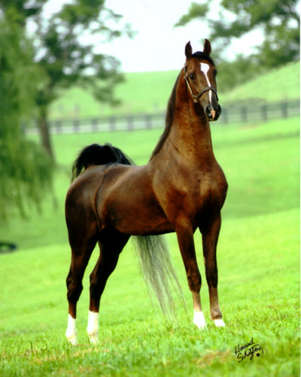
American Saddlebred

Slide 20
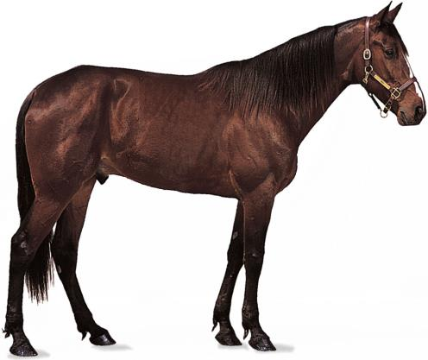
American standardbred

Slide 21
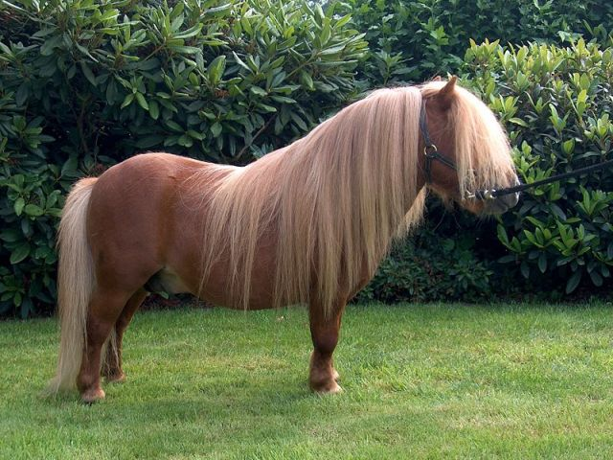
Shetland

Slide 22
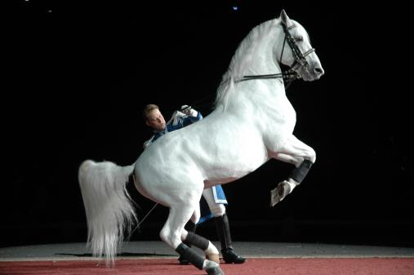
Lipizzaner
Origin
  Austria
Classification
  Light
Height
  15-16hh
Color
  Mostly gray

Slide 23
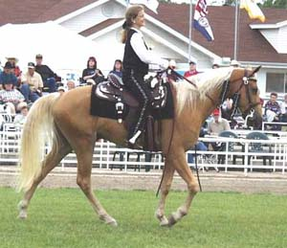
Missouri Fox Trotter

Slide 24
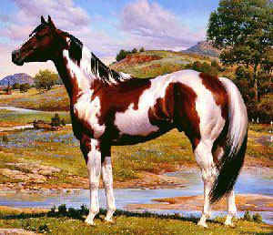
Paint

Slide 25
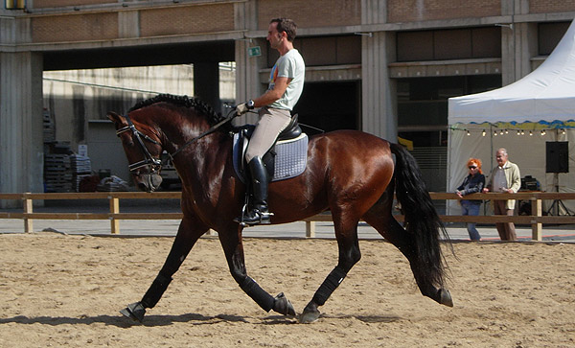
Andalusian

Slide 26
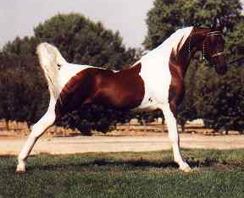
American Saddlebred

Slide 27
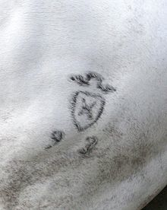
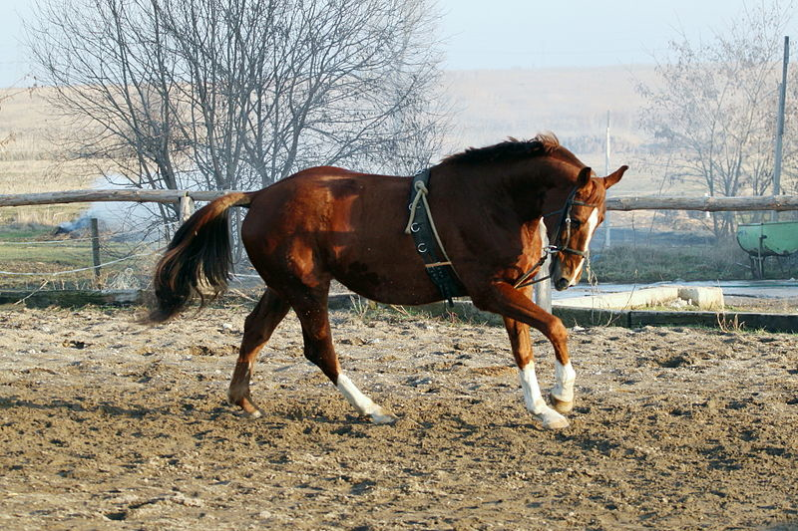
Holstein

Slide 28
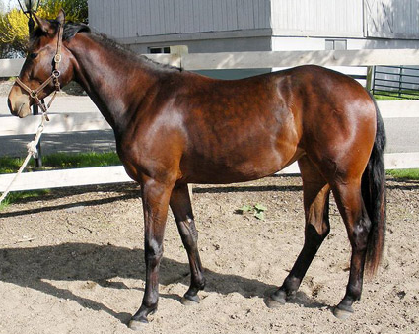
American warmblood

Slide 29
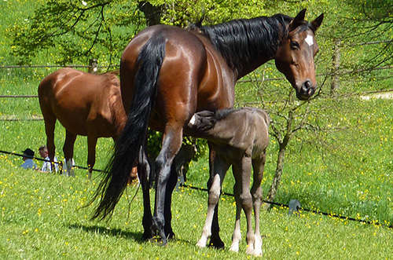
Wurttemburg

Slide 30
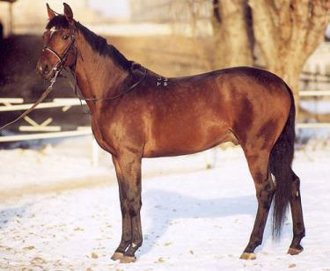
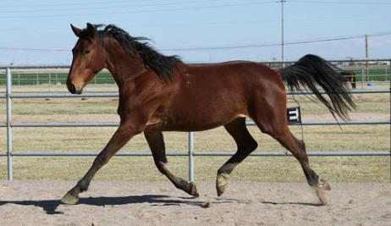
Trakehner
Other Info:
  Primary breeding area is now
  Germany
  Natural elegance and balance
  Performance horse

Slide 31
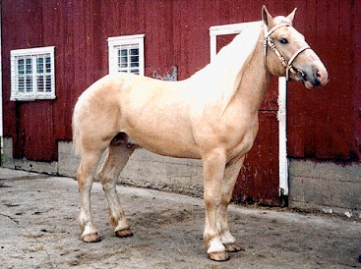
American Cream

Slide 32
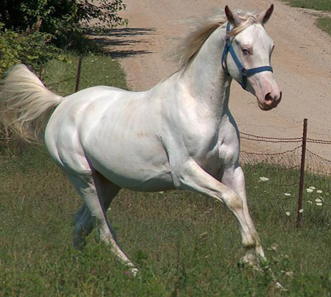
American albino

Slide 33
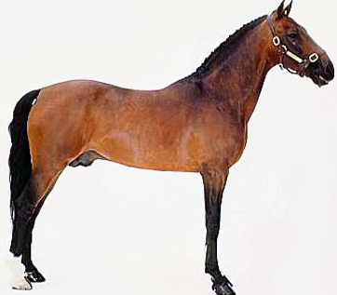
hackney

Slide 34
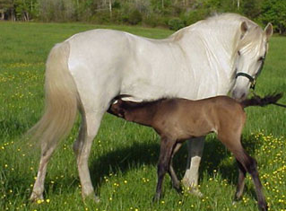
andalusian

Slide 35
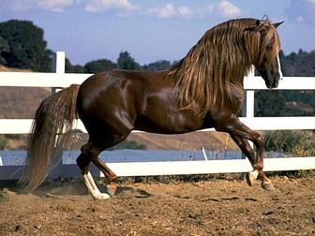
Peruvian paso / paso fino

Slide 36
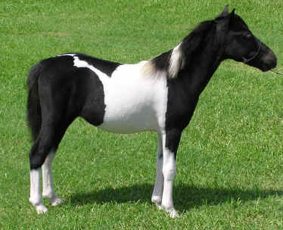
Miniature Horse

Slide 37
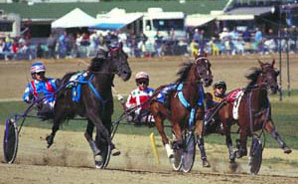
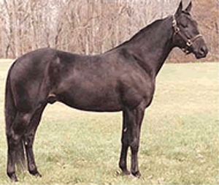
American Standardbred

Slide 38
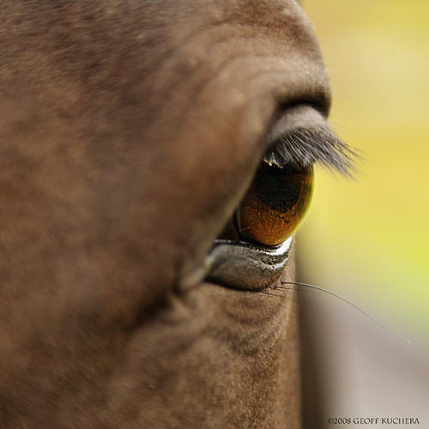
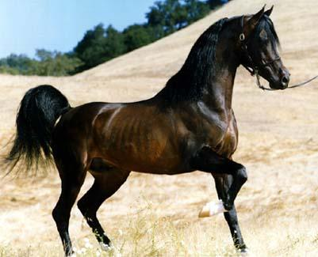
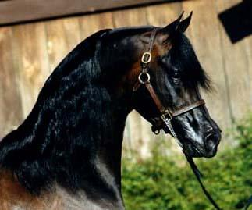
arabian

Slide 39
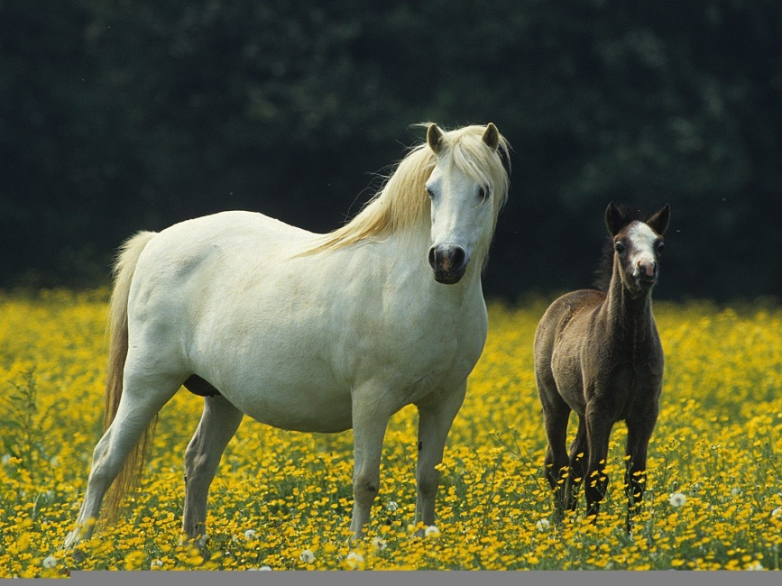
Welsh Pony

Slide 40
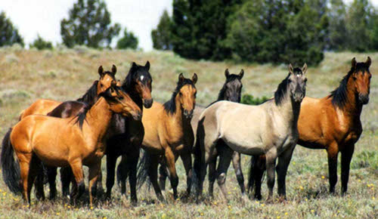
Mustang

Slide 41
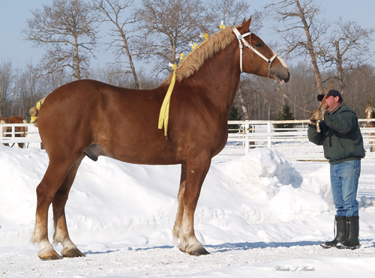
belgian

Slide 42

American quarter horse

Slide 43



American Warmblood

Slide 44

Andalusian

Slide 45

Morgan

Slide 46


American Saddlebred

Slide 47

Highland

Slide 48


appaloosa

Slide 49

Shetland

Slide 50

arabian

Slide 51

Miniature Horse

Slide 52

barb

Slide 53

Shire

Slide 54

Selle Francais
Origin
  France
Classification
  Light
Height
  15.2-17 hands

Slide 55

Hanoverian

Slide 56

Belgian

Slide 57


Barb

Slide 58

American Quarter Horse

Slide 59


Fresians
Heavily feathered legs
Breed was “lightened” for
carriage and sport horse
Tail and mane may touch
ground

Slide 60

Thoroughbred

Slide 61

appaloosa

Slide 62


Welsh Pony

Slide 63

Paint

Slide 64

Highland

Slide 65

Missouri Fox Trotter

Slide 66

Hanoverian

Slide 67

American cream

Slide 68

Palomino

Slide 69

Clydesdale

Slide 70


Peruvian paso / paso fino

Slide 71

Pinto

Slide 72

Holstein

Slide 73

hanoverian

Slide 74

Shire

Slide 75

Morgan

Slide 76

Clydesdale

Slide 77

Miniature Horse

Slide 78

Tennessee Walking Horse

