Slide 1
Kentucky Agricultural Education
Record Keeping
Instructions & Examples
This Presentation provides background on record keeping and guides you through profile set-up on the AET.

Slide 2
SETTING UP YOUR PROFILE

Slide 3
Setting up your AET Profile
All records are kept on the Ag. Experience Tracker- www.theaet.com
Once you are on the website, begin by clicking the yellow “student” tab
Enter the information provided by your teacher to log on

Slide 4
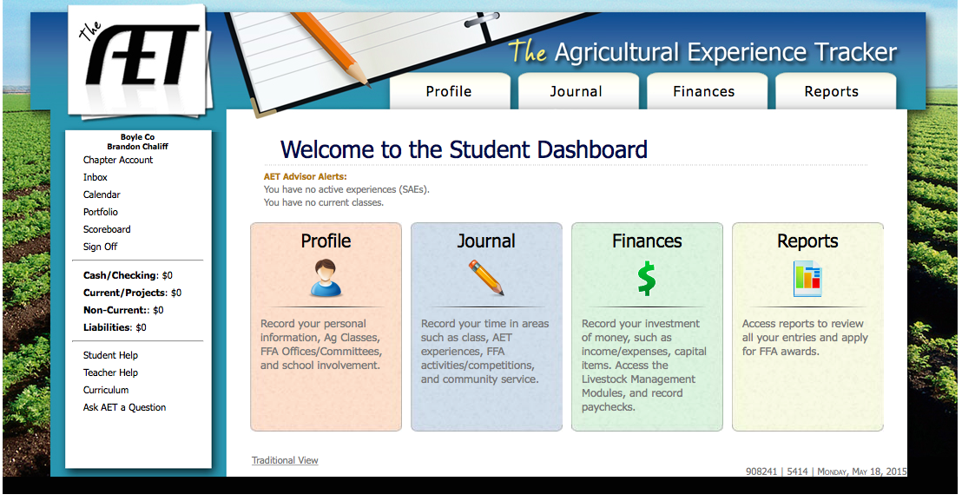
You will see the following page. This the home page for your AET account.

Slide 5
Click “Profile” to begin

Slide 6
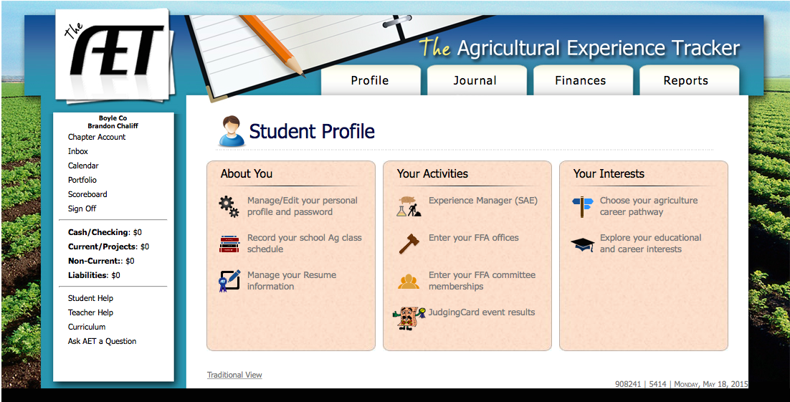
From here, you can manage your Personal Info, Ag. Classes, SAE, FFA offices and committee memberships

Slide 7
Begin by clicking on “Manage/Edit your personal profile and password”.

Slide 8
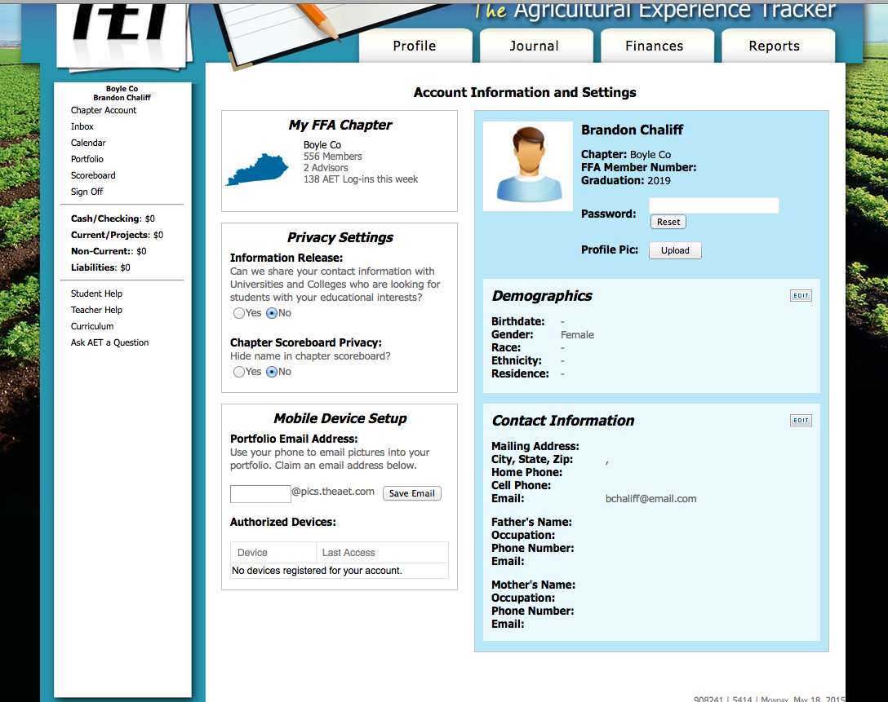
You will see this screen. It is important to fill out this information and keep it updated, because it will appear on FFA applications.

Slide 9
With the mobile device set-up feature, you can create an email to send pictures of your SAE directly to the website. You can find the pictures in “Portfolio”

Slide 10
If you wish, you can change the password for your account, just be sure to make it something easy to remember!

Slide 11
Next, fill in your Demographic Information

Slide 12
Followed by your contact information. Please make sure all information is accurate, then return to “Profile”.

Slide 13
Next, click on
“Record your school Ag. Class Schedule”

Slide 14
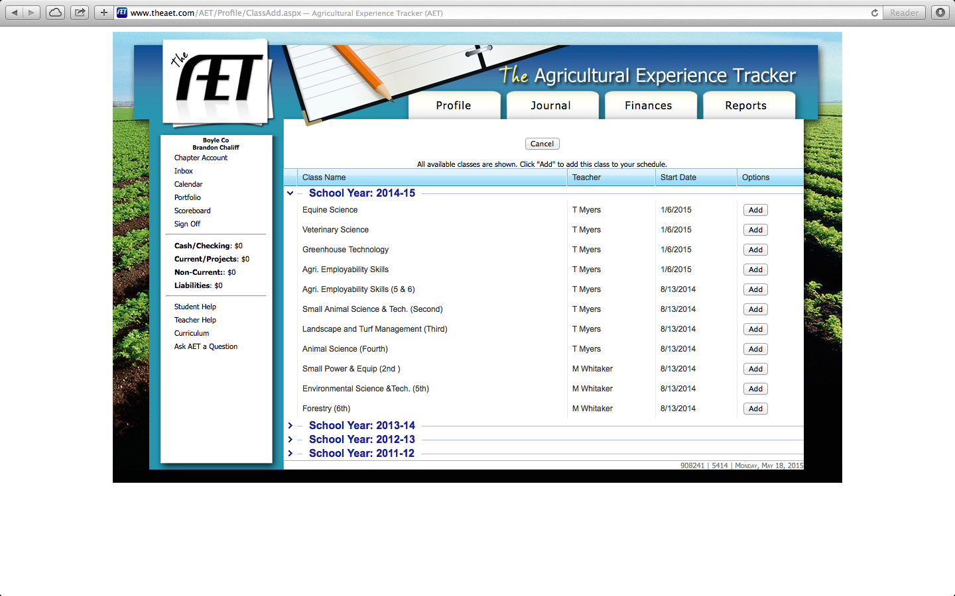
Click “Add” next to the class(es) in which you are enrolled. Then return to your profile.

Slide 15
The following slides are only for FFA members who are officers or who are members of a committee.

Slide 16
Next, Click on “Enter your FFA Office”.

Slide 17
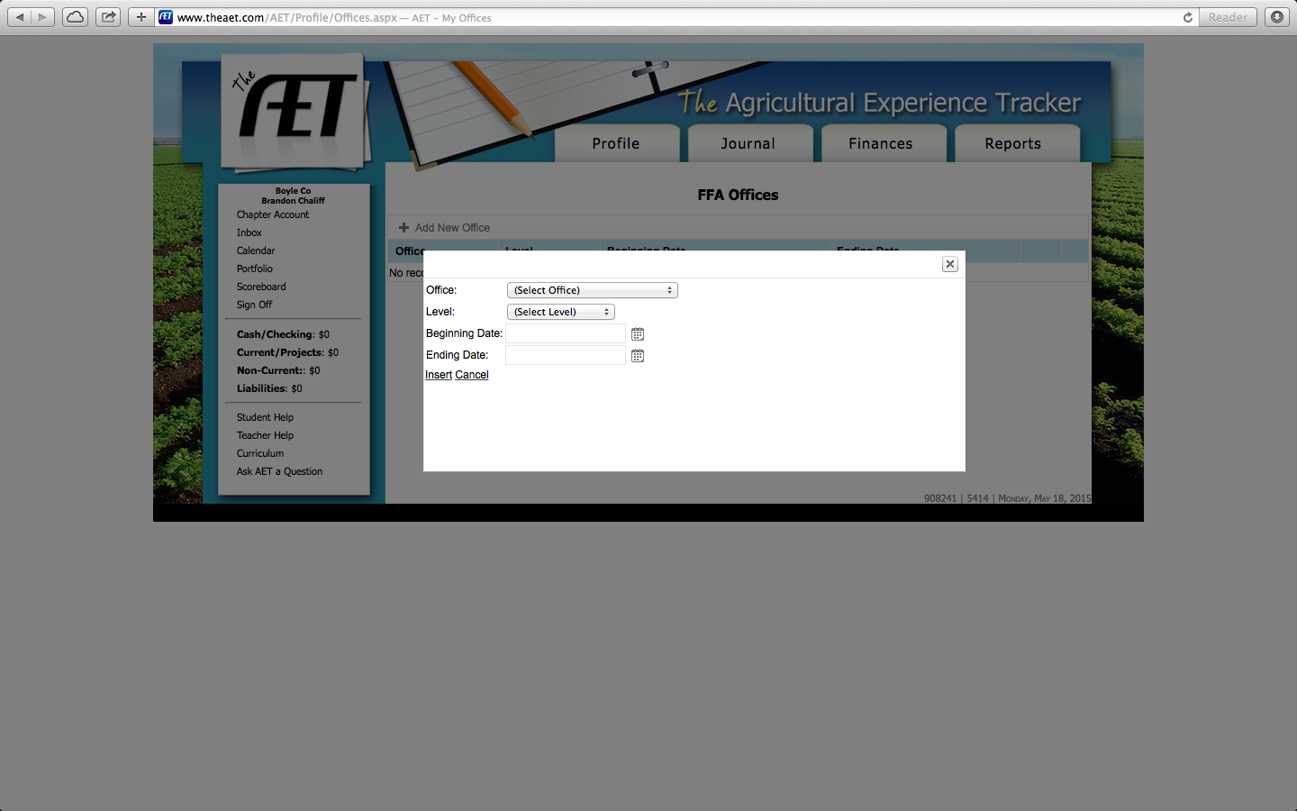
Click on “Add New Office” and enter the appropriate information. Then return to the profile page.

Slide 18
Next, click on “Enter your FFA committee memberships”

Slide 19
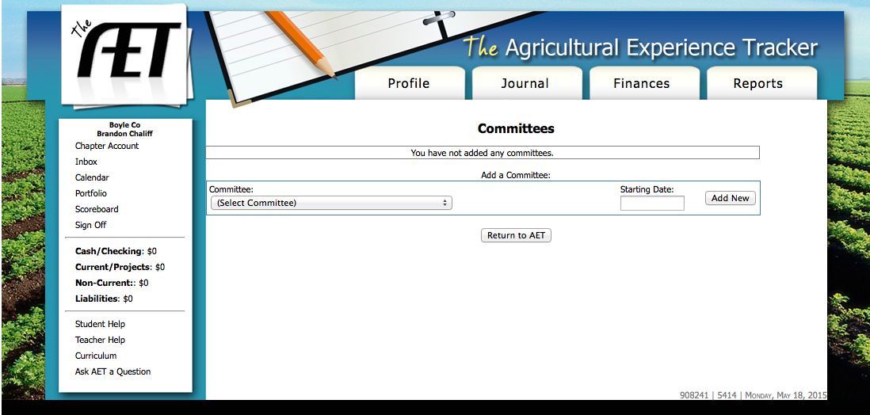
Fill in the Appropriate information, then return to your AET Home Page.

Slide 20
Resume
You also have the option of completing the resume section of the journal page. This may also be completed by filling in the previous FFA information or during the state degree process.

Slide 21
To work on your resume, click “Manage your resume information”

Slide 22
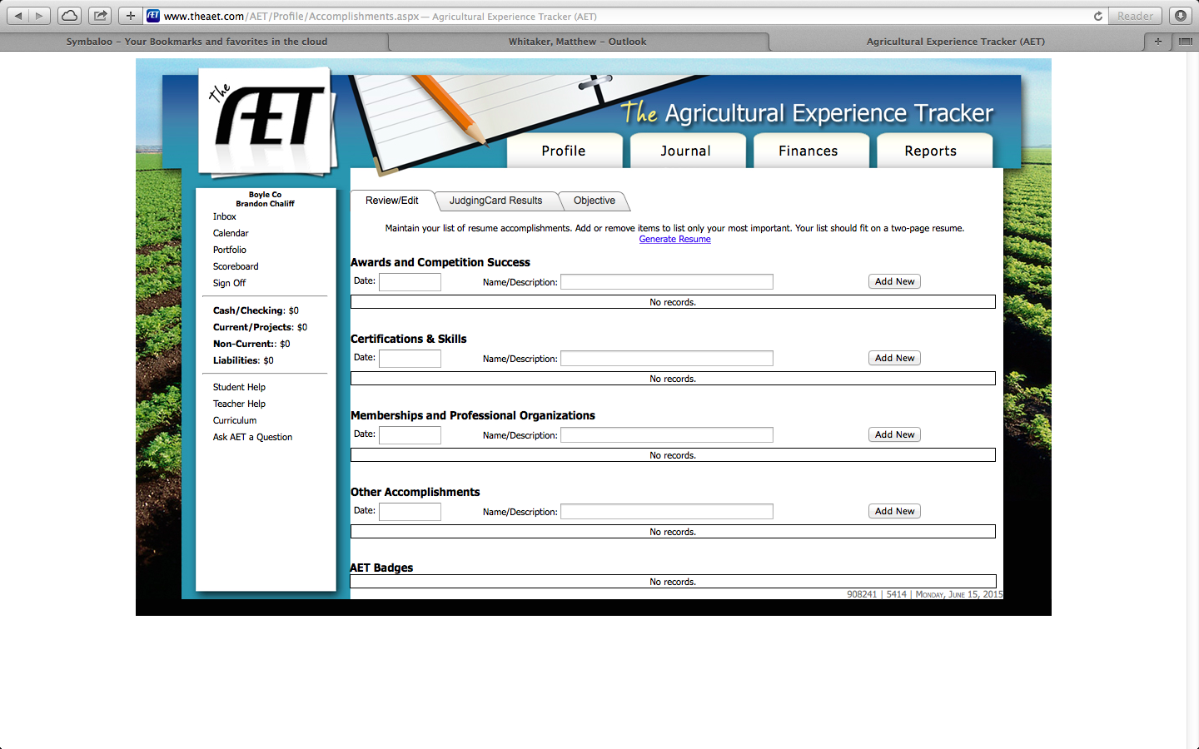
The following page will appear. Simply type in the information and click “add new” to enter further activities.

Slide 23
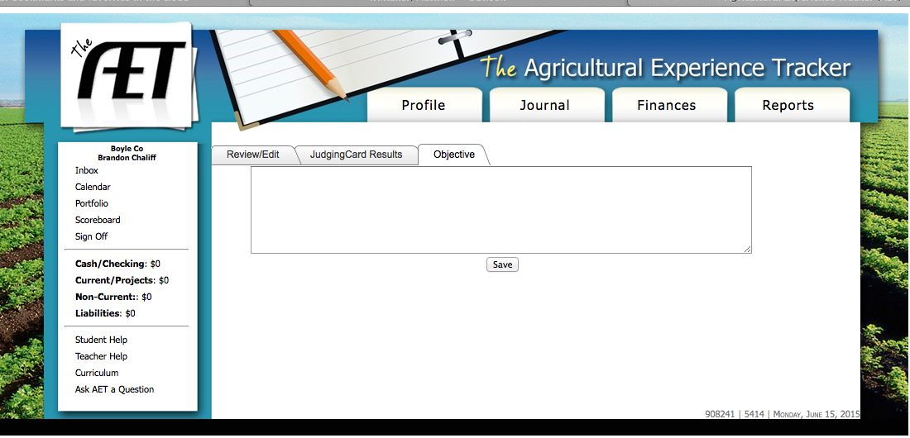
This is the “Objective” tab. Here you can enter information about your career objective.

Slide 24
Your profile is now complete. Next, we will learn about the “Journal” Section of the AET.

