Slide 1
Kentucky Agricultural Education
Record Keeping
Instructions & Examples
This Presentation provides background on record keeping and guides you through profile set-up on the AET.

Slide 2
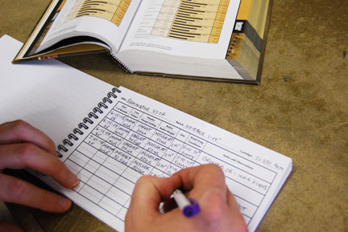

Importance of Keeping Records
Teaches good financial practices
Used as a planning tool
Helps determine net profit/loss of the SAE
Can be used as a decision making tool
Used for filling out income taxes

Slide 3


Importance of Keeping Records
Basis for credit
Proof of bills paid
Proof of income
Necessary for social security contributions
Necessary for insurance
coverage/claims
Help you keep track of inventory-
including livestock

Slide 4


Importance of Keeping Records
Leads to success in filling out applications for proficiency competitions
Crucial to having an accurate State or American Degree Application

Slide 5
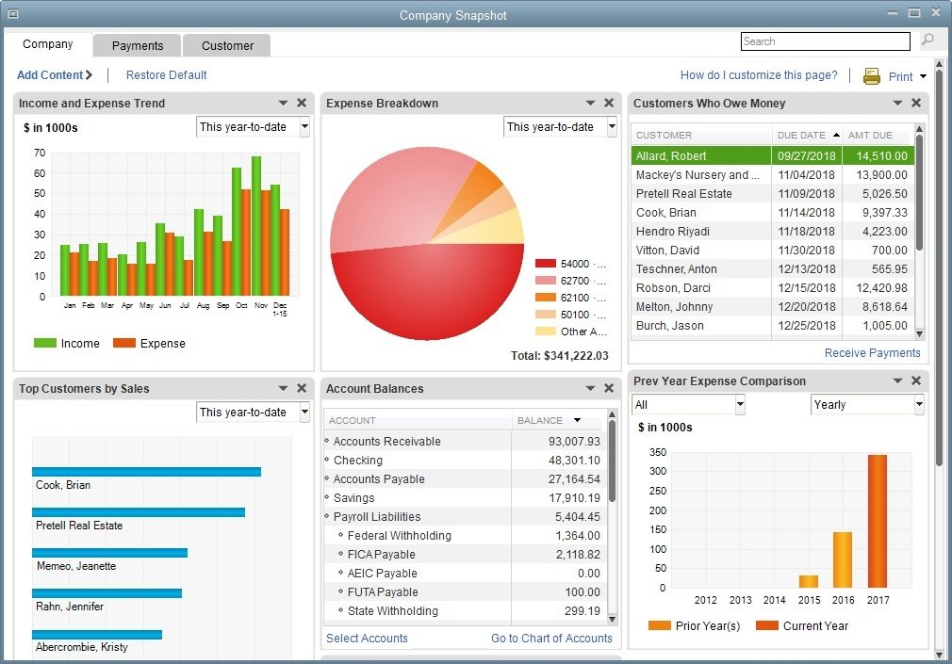
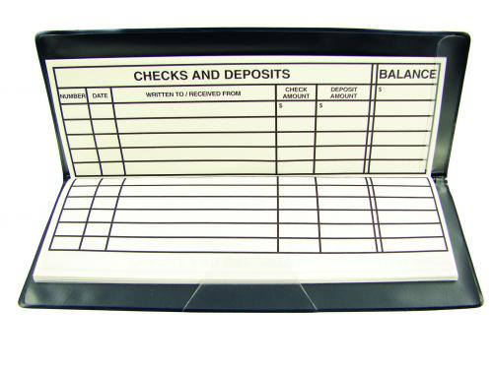
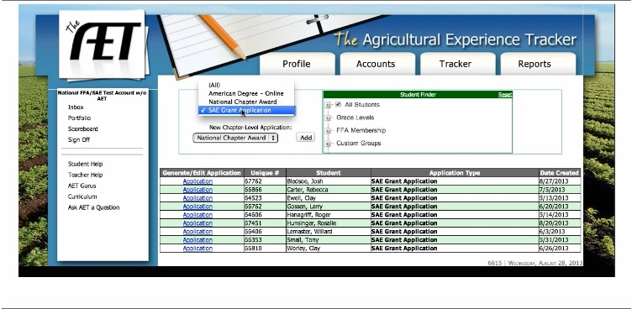
Record Keeping Options

