Slide 1
Kentucky Agricultural Education
Record Keeping
Instructions & Examples
This Presentation provides background on record keeping and guides you through profile set-up on the AET.

Slide 2
By Now You…
Understand the SAE concept
Have set up a profile in AET (Ag Experience Tracker)
Recognize the importance of record keeping
Have chosen an SAE project
Now it’s time to prep the experience in AET

Slide 3
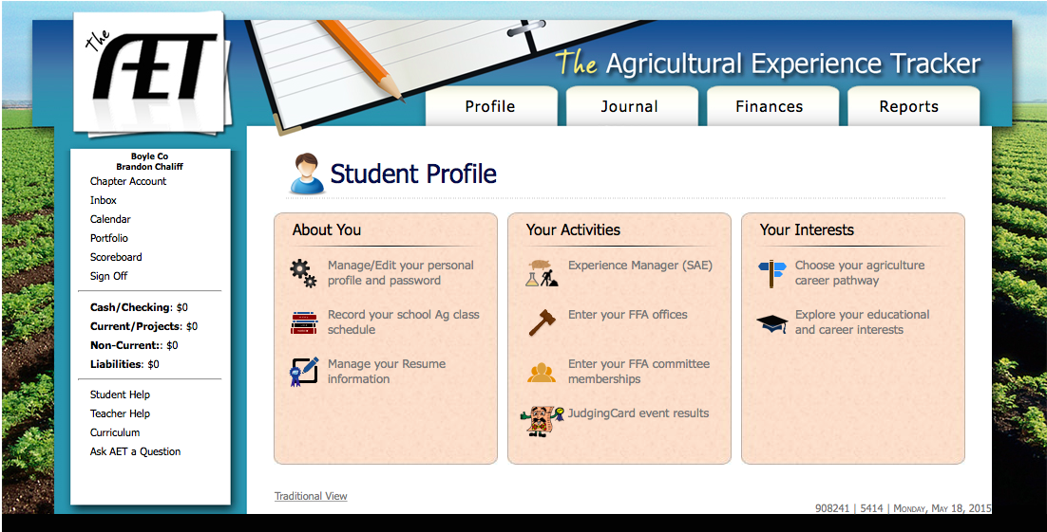
Next, click on
“Experience Manager (SAE)”

Slide 4
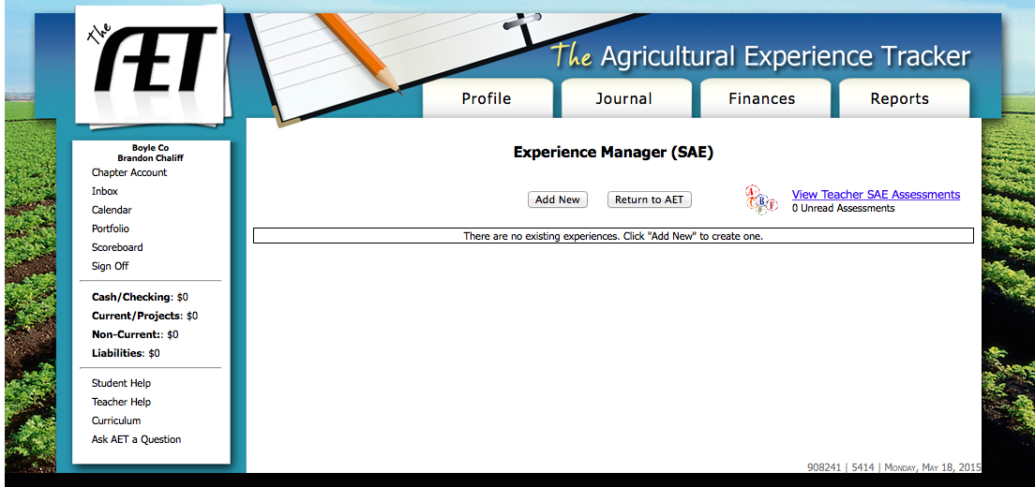
The screen will look like this.
Click “Add New”

Slide 5
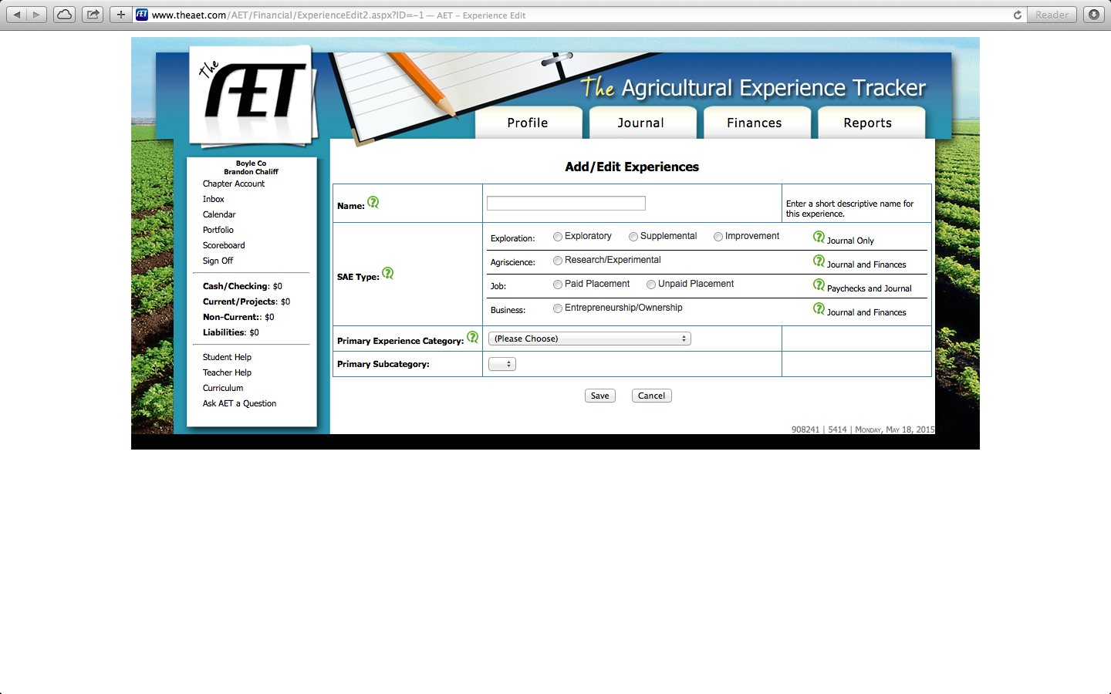
Next, you will enter all important information about your SAE. Click on the green question marks or ask your agriculture teacher if you have any questions.

Slide 6
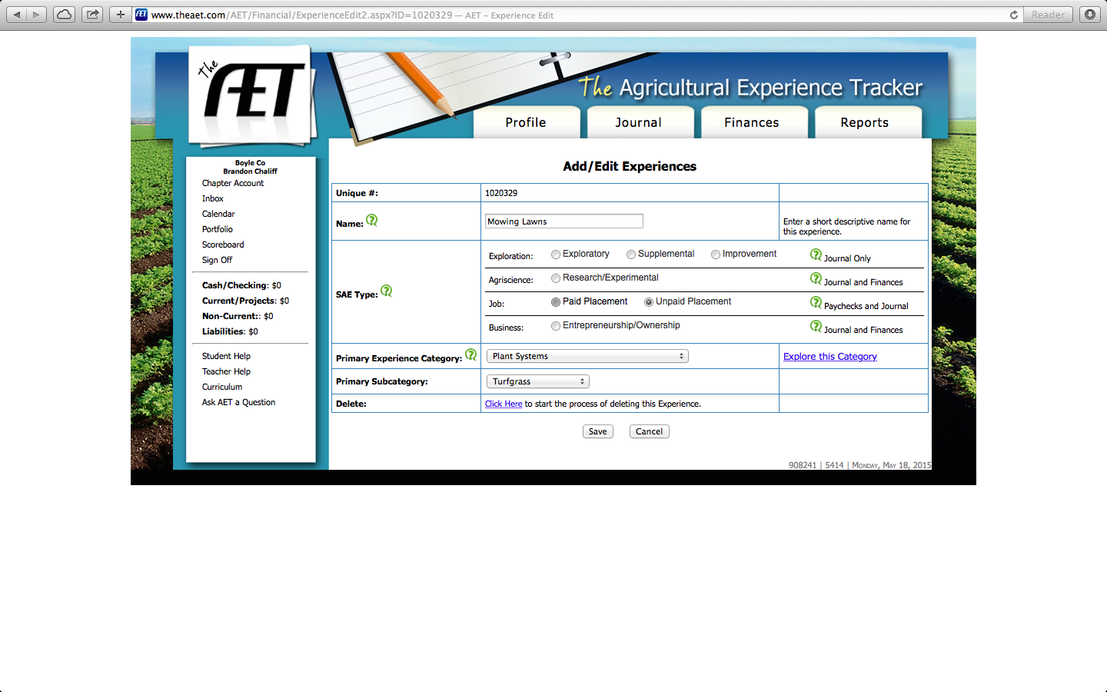
Here is an example of a student who has completed their SAE Experience Manager Page.

Slide 7
If necessary, return to the Experience Manager page to add multiple SAEs.

Slide 8
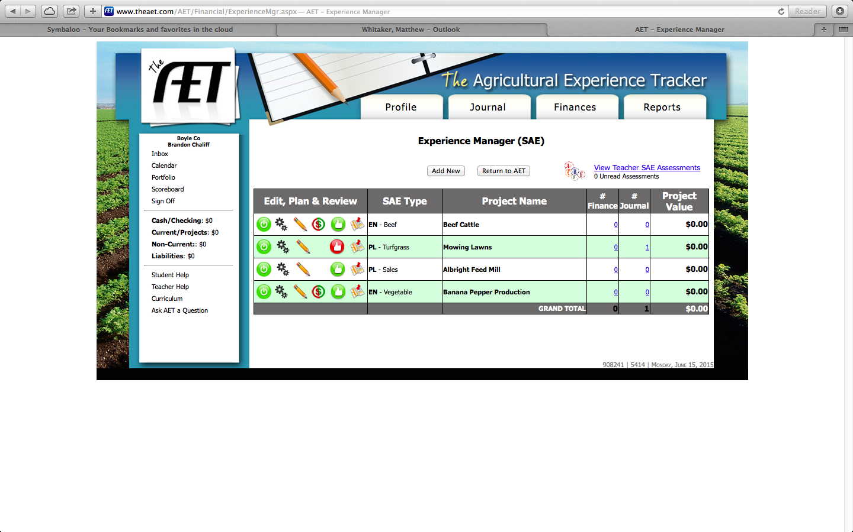
This is what your experience manager page will look like after entering your SAE projects.

Slide 9
The green power button indicates that the SAE is considered active. Clicking that button will make the SAE inactive and any records entered relating to that project won’t count on any applications.

Slide 10
Clicking the gears will allow you to edit your SAE project information.

Slide 11
Clicking the pencil will enter you into the SAE planning tool. This is your first assignment in class for your SAE project.

Slide 12
The dollar sign enters you into the “Estimate income/expense” feature. This only shows up on entrepreneurship projects and should only be done after checking with your agriculture teacher.

Slide 13
The “thumbs up” takes you to the annual review of scope. A red button indicates that there are blank boxes in the annual review.

Slide 14
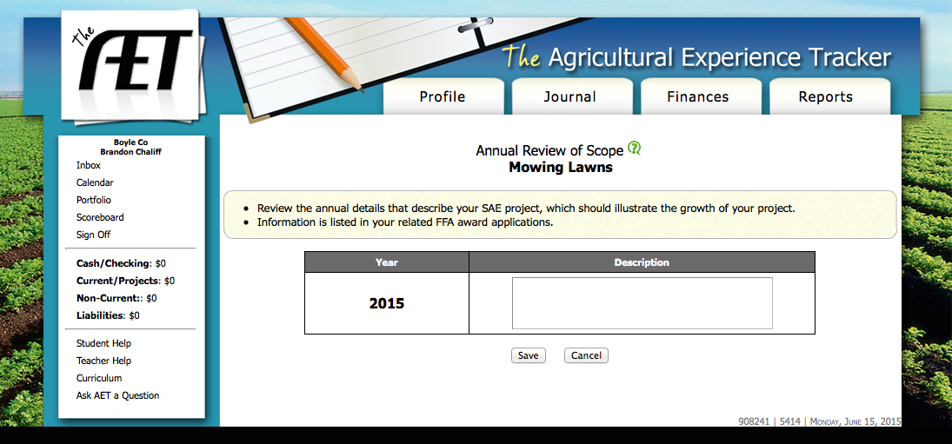
This is the annual review of scope. Information entered here will show up on page 7 of a proficiency application or page 4 of a degree application.

Slide 15
The map feature allows you to pinpoint the location of your project. This can be helpful for your teacher when doing SAE visits.

Slide 16
Clicking on the links under # Finance or # Journal will allow to review financial or journal entries for your project. The number tells you the total number of entries for each.

Slide 17
Once you have added all SAEs return to the Profile page.

