Slide 1
Before you print…
A couple more useful tidbits of information about the AET before you print degrees/proficiencies

Slide 2
Many students who print State/American Degrees or Proficiencies may have trouble with some aspects of finishing their application because of certain steps you must take before printing. Following these steps will make sure that ALL information automatically transfers to the degree or proficiency form.

Slide 3
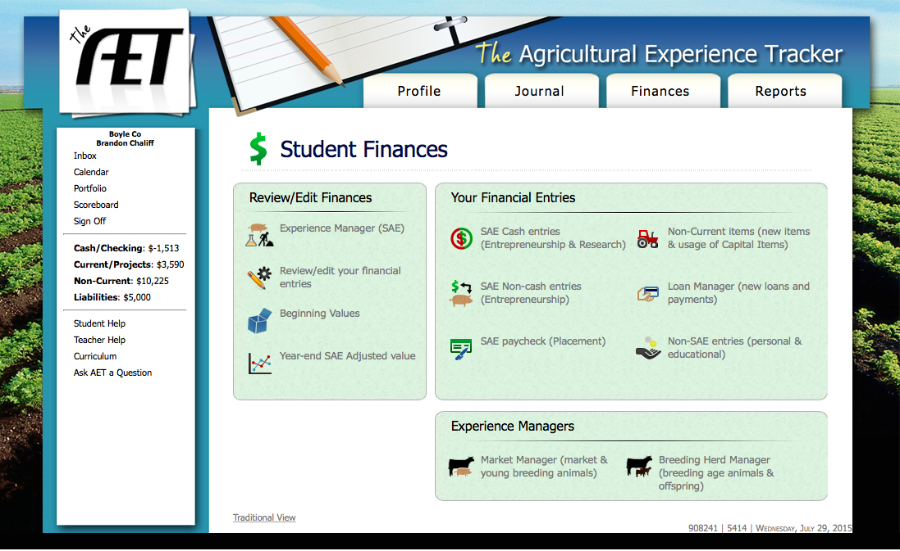
#1 Capital Item Usage(Entrepreneurship Only)
Click on “Non-Current Items” under the Financial tab.

Slide 4
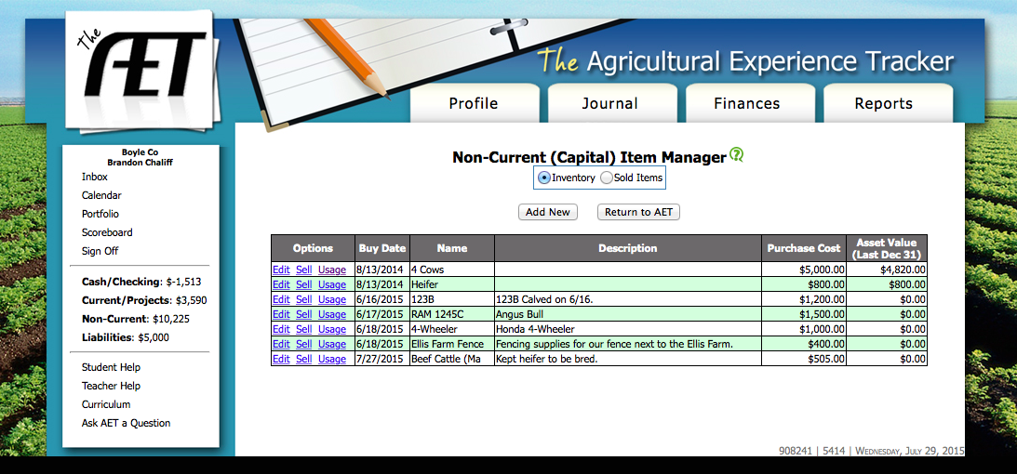
Under “Options” there is a link to “Usage”. Click the link for the item you need on the application. If there are multiple items, you will have to edit them one at a time.

Slide 5
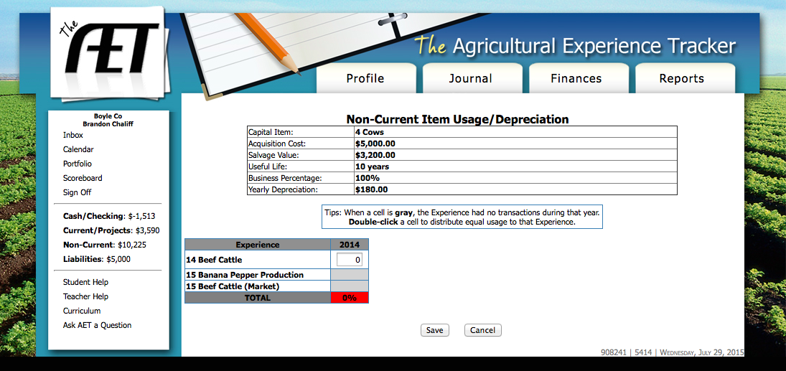
For each year of the project, there will be a % usage number for each entrepreneurship SAE. If this number is 0, the item will not be counted on the application.

Slide 6

Simply double click in the box next to the arrow to change it to 100% usage. Click Save. The full value of the item will then be counted toward the application.

Slide 7
Side Note: If the student entered the full value of the item in their records, but they need to count less than 100% of the value for the application, then you will have to adjust that number from 100% to the appropriate percentage.

Slide 8
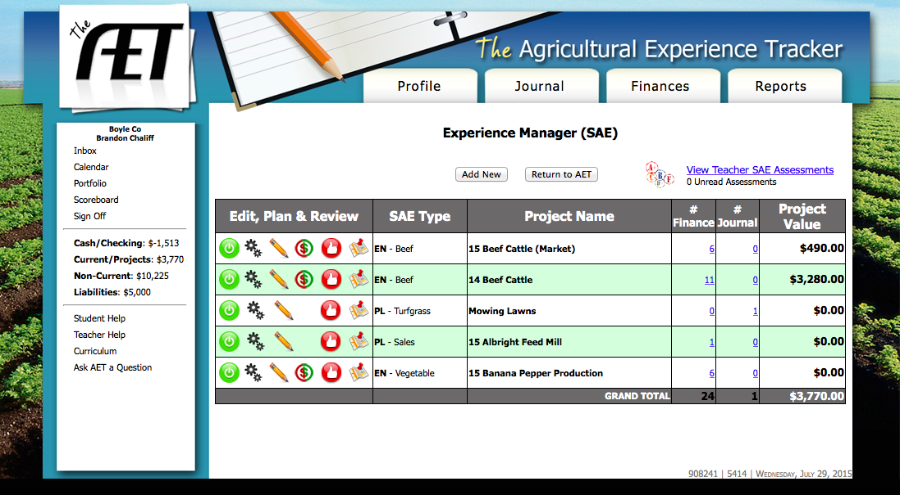
#2 Annual Review (All Projects)
Begin by clicking the red thumb print for the SAE related to the application.

Slide 9
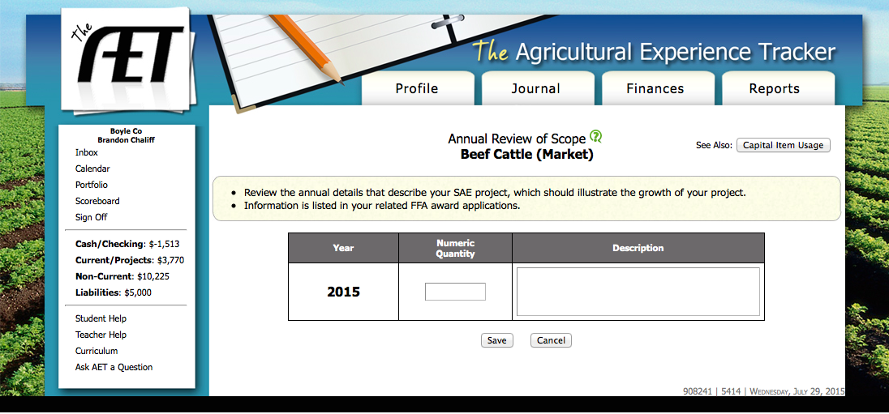
This is the Annual Review of Scope. Here you can enter information that will show up on the “Hours & Wages” or “Entrepreneurship Details” of the state degree form or proficiency.

Slide 10
#3 Year-end Adjusted Value (Entrepreneurship Only-as needed). Begin by clicking the appropriate link under the financial tab.

Slide 11
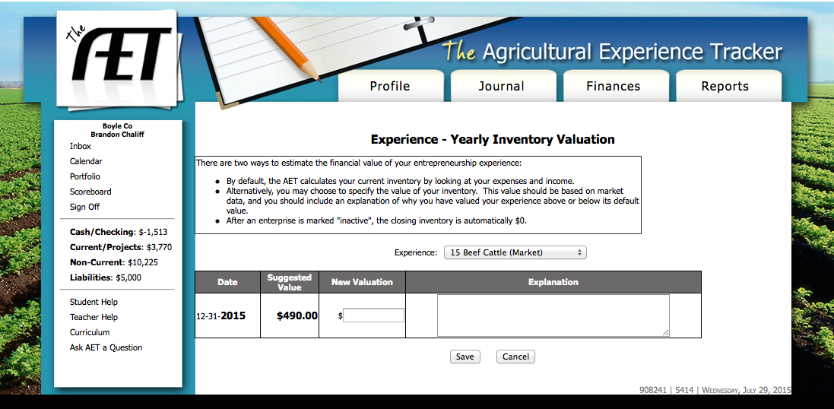
On this page, if a project’s current inventory is not adding up correctly, you can adjust the number from this page. This value will over-ride other values for current inventory and will show up on student applications.

Slide 12
As a reminder, there are also many ways of reviewing student entries prior to generating an award application. This can be done under the journal tab, the financial tab or the report tab.

