Slide 1
Parasite ID
Veterinary Science CDE Prep
RCHS Ag Ed

Slide 2
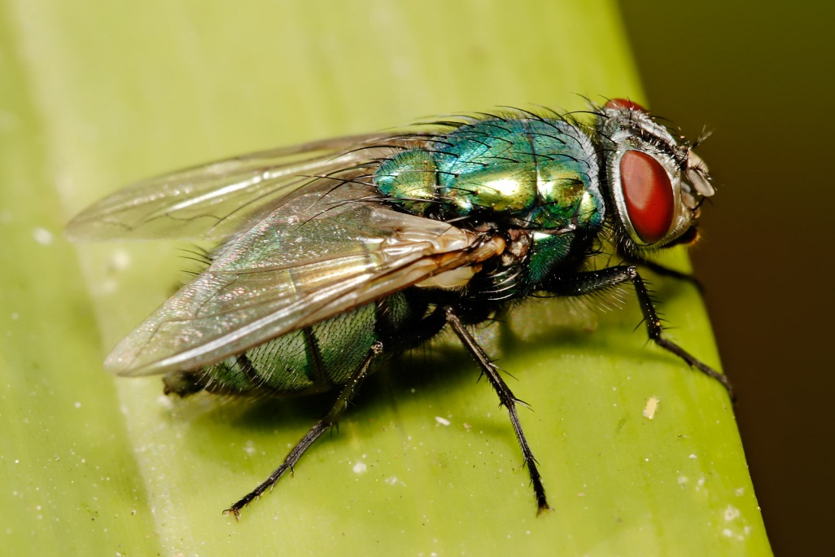
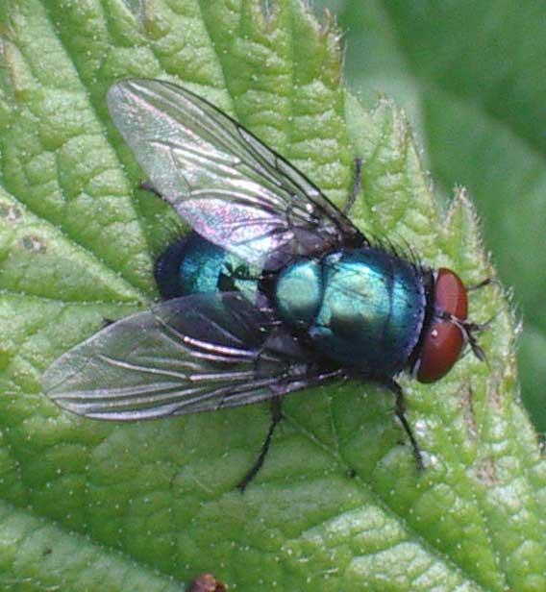
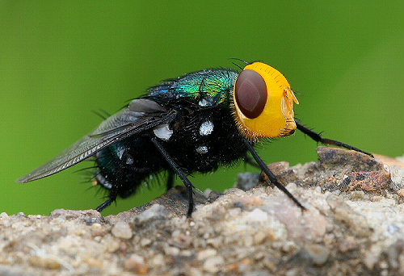
Blowfly
(Family Calliphoridae)

Slide 3
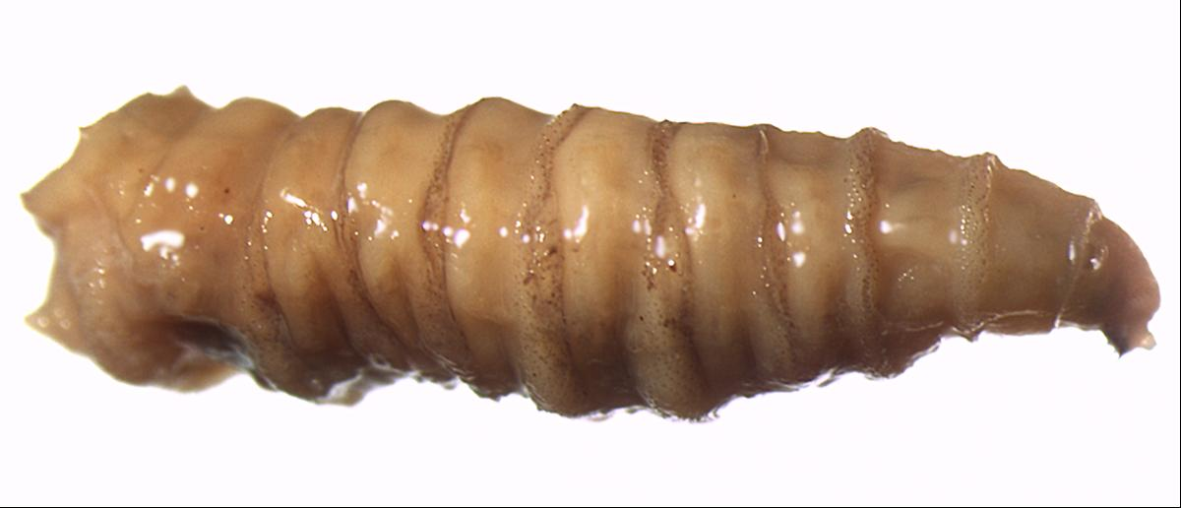
Blowfly Maggot
(Family Calliphoridae)

Slide 4
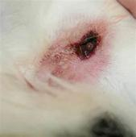
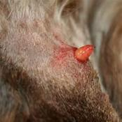
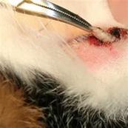
Cat warble
(Genus cuterebra)

Slide 5
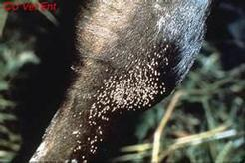
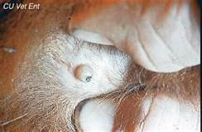
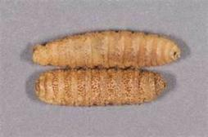
Cattle grub
(Genus hypoderma)

Slide 6
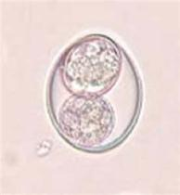
Coccidia
(Genus isospora or eimeria)

Slide 7
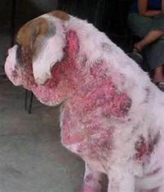
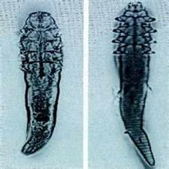
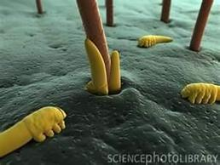
Demodectic mite
(genus demodex)

Slide 8
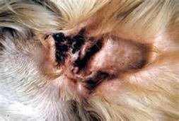
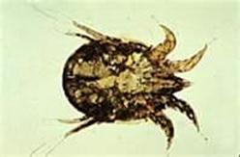
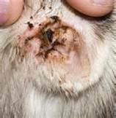
Ear mite
(family ascaridae; genus otodectes)

Slide 9
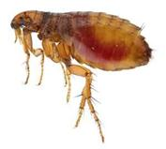
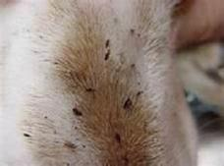
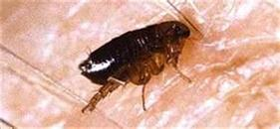
Fleas
(genus ctinocephalides)

Slide 10
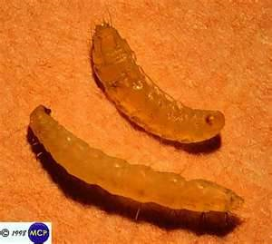
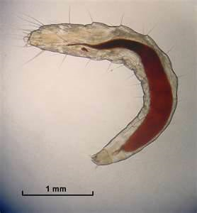
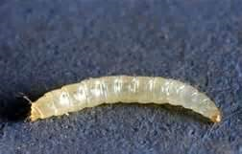
Flea larva
(genus ctinocephalides)

Slide 11
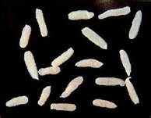
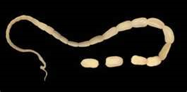
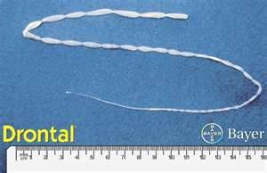
Flea tapeworm
(genus dipylidium)

Slide 12
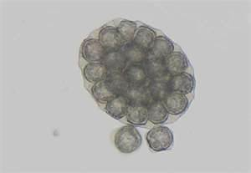
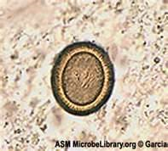
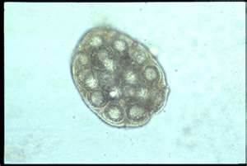
Flea tapeworm egg
(genus dipylidium)

Slide 13
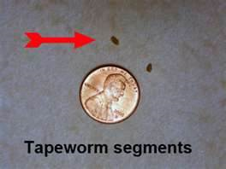
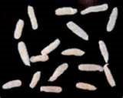
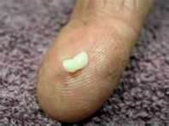
Flea tapeworm segment
(genus dipylidium)

Slide 14

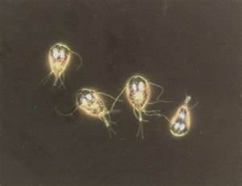
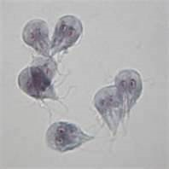
Giardia
(genus giardia)

Slide 15
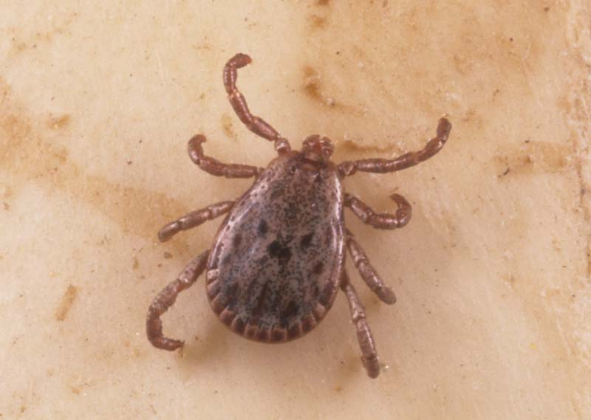
Hard tick
(Family ixodidae; genus amblyomma or dermacentor)

Slide 16
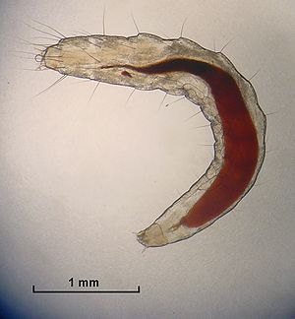
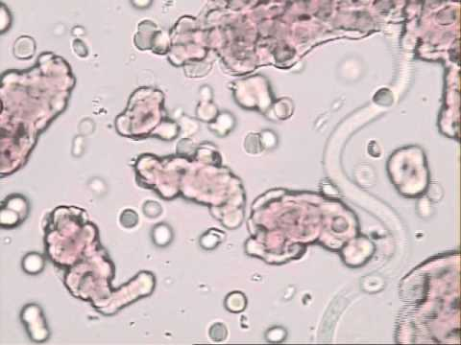
Heartworm
(genus dirofilaria)

Slide 17
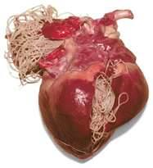
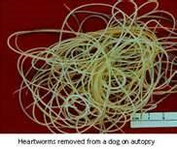
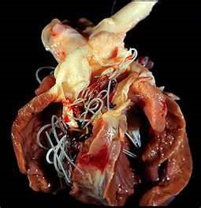
Heartworm adult
(genus dirofilaria)

Slide 18
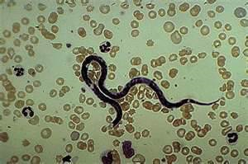
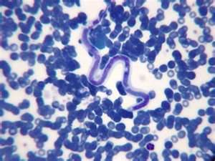
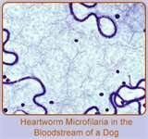
Heartworm microfilaria
(genus dirofilaria)

Slide 19
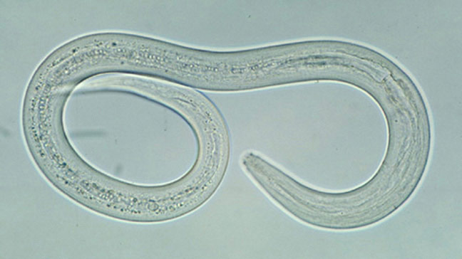

Hookworm adult
(family ancylostomatidae; genus amcylostoma, uncinaria, bunostomum orglobocethalus)

Slide 20
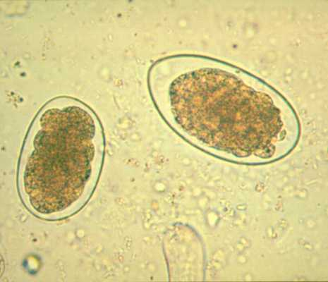
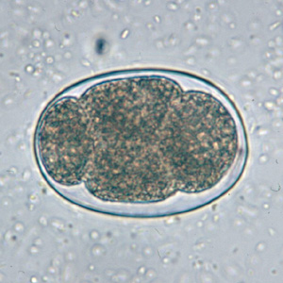
Hookworm egg
(family ancylostomatidae; genus amcylostoma, uncinaria, bunostomum orglobocethalus)

Slide 21
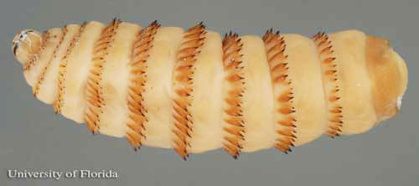
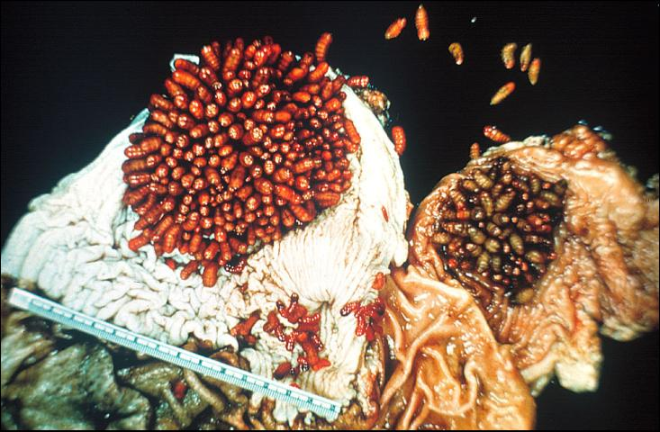
Horse bots
(genus gasterophilus)

Slide 22
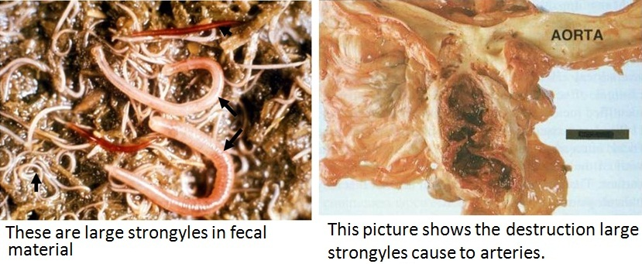
Horse strongyles
(family strongylidae; genus strongylus)

Slide 23
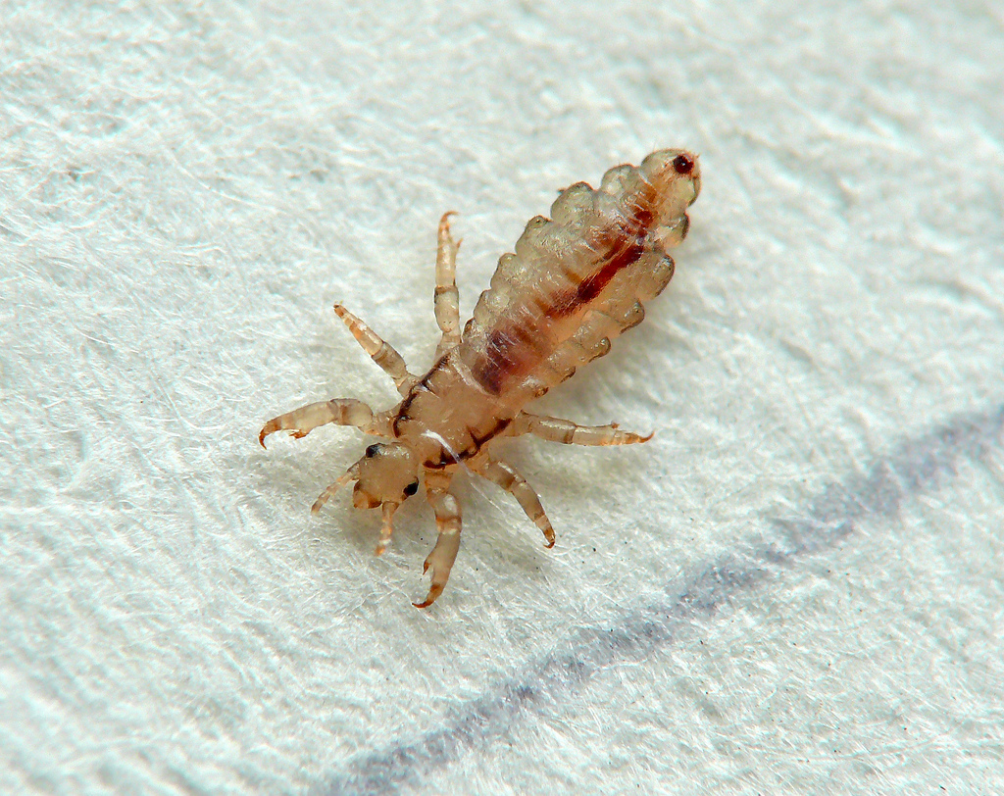
Lice – biting
(order mallothaga; genus bovicola or trichodectes)

Slide 24

Lice – sucking
(order anoplura; genus linognathus or hamatpinus)

Slide 25

liver fluke
(class trematoda; genus fasciola, fascioloides, of dicroceolium)

Slide 26


lungworm
(family metastrongylidae; genus metastrongylus, dictyocaulus or aelurostrongylus)

Slide 27

Mosquito adult
(Family culicidae; genus anopheles, Culex or aedes)

Slide 28

Mosquito larva
(Family culicidae; genus anopheles, Culex or aedes)

Slide 29

Pinworm
(genus oxyuris)

Slide 30

Roundworm adult
(family ascaridiae or toxocaridae; genus toxocara, toxocaris, ascaris, parascaris or neaoascaris)

Slide 31

Roundworm egg
(family ascaridiae or toxocaridae; genus toxocara, toxocaris, ascaris, parascaris or neaoascaris)

Slide 32


Sarcoptic mite
(family ascaridae; genus sarcoptes or notoedres)

Slide 33

Taenia tapeworm
(family taeniidae; genus taenia)

Slide 34

Taenia tapeworm egg
(family taeniidae; genus taenia)

Slide 35


Taenia tapeworm segment
(family taeniidae; genus taenia)

Slide 36


Soft tick
(family argasidse; genus otobius or argas)

Slide 37



Whipworm
(genus trichuris)

Slide 38



Whipworm egg
(genus trichuris)

